Slide 1
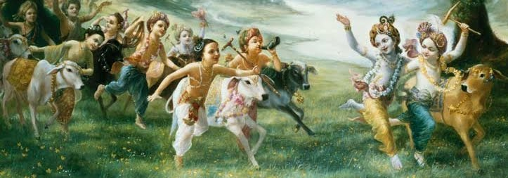
Gokul Bhajan & Vedic Studies
VA-015
Nov 21, 2015
Gokul Bhajan
Hari Katha
Notes:
Om Ajnana timirandhasya, jnananjana salakaya
Caksur unmimiltam yena, tasmai sri gurave namah
Namah om vishnu padaya, radhikayah priyatmane
Sri-srimad bhaktivedanta, narayana iti namine
Narayanam gurum vande, Saranam bhakta bāndhavam
Gaura manobhishtam poornam, Radha dāsyam pradāyakam
Rupānugācarya varyam, Rupa manjari preshtakam
Patita pāvana bāndhava, Yugācarya nārāyanam
Sri krishna lila kathane sudaksham, Audarya-madhurya gunais ca yuktam
Varam varenyam purusham mahantam, Narayanam tvam sirasa namami
He krishna karuna sindho, dina bandho jagat pate
Gopesha gopika kanta, radha kanta namo ‘stu te
Tapta kancana gaurangi, radhe vrindavaneshvari
vrsabhanu sute devi, pranamami hari priye
bhajami radham aravinda netram, smarami radham madhurasmi-tasyam
vadami radham karuna bharardram, tato mam anyasti gatir na kapi
bhaktya vihina aparadha-laksaih, ksiptas ca kamadi-taranga-madhye krpamayi tvam saranam prapanna, vrnde namas te caranaravindam

Slide 2
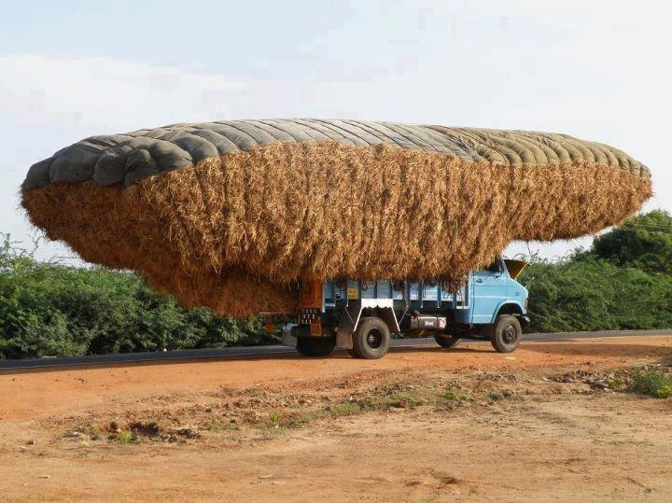
Only in India

Slide 3
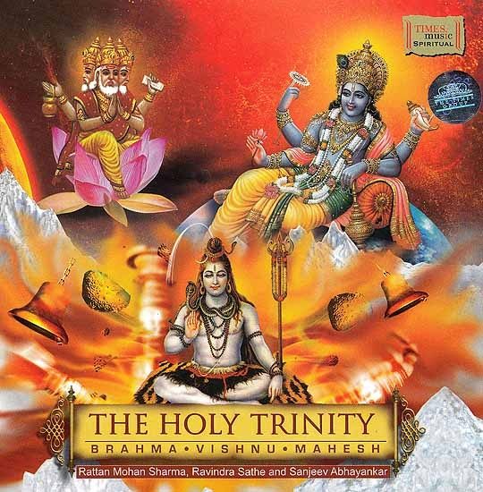
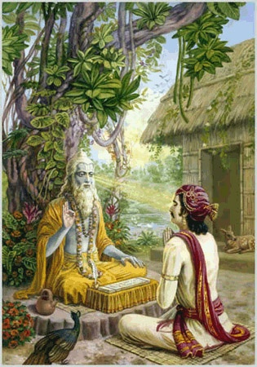
Gurur brahma gurur vishnuh
Gurur devo maheshwarah
Gurur sākşāt para-brahma
Tasmai sri gurave namah
Guru is Brahma, Vishnu and Maheshwara.
Guru, as brahma, plants the seed of bhakti.
Guru, as Vishnu, nourishes the creeper of bhakti.
Guru, as Maheshwar, destroys all obstacles in the path of bhakti.
Guru is non-different from supreme lord.
To that guru, I offer my obeisances.

Slide 4
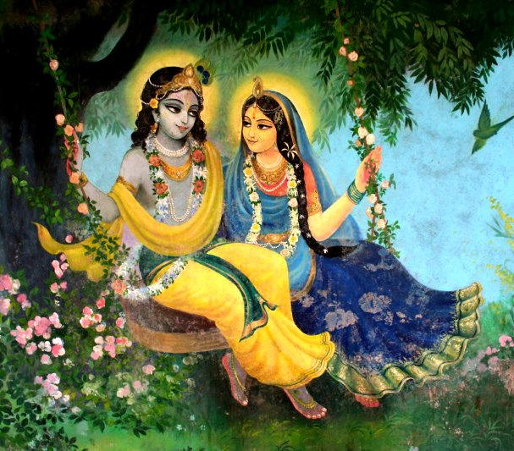
Jaya Rādha Mādhava
Jaya Kunja Vihārī
Jaya Gopī Jana Vallabha
Jaya Giri Vara Dhārī ... (Jaya)
Yaśodā Nandana Vraja Jana Ranjana
Yamunā tīra Vana Cāri ... (Jaya)
[ Hare Krishna Hare Krishna
Krishna Krishna Hare Hare
Hare Rāma Hare Rāma
Rāma Rāma Hare Hare ]

Slide 5
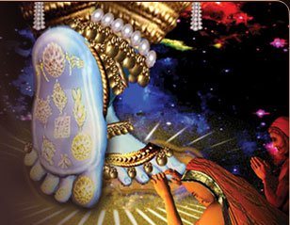
kṛṣṇāya vāsudevāya
haraye paramātmane
praṇata-kleśa-nāśāya
govindāya namo namaḥ (S.B. 10.73.16)
[ praṇata— of those who have surrendered; kleśa— of the distress; nāśāya— to the destroyer; ]
Again and again I offer my obeisances unto Lord Kṛṣṇa, Hari, the son of Vasudeva. That Supreme Lord, Govinda, vanquishes the suffering of all who surrender to Him.

Slide 6
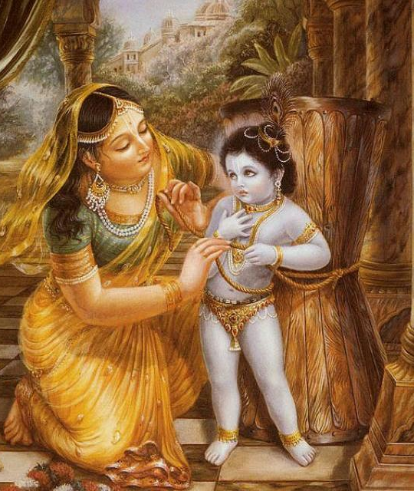
GB-02
Krishnaya Govindaya
Yashoda-nandanaya ca
Nanda-gopa-kumaraya
Damodaraya namo namah
- Gokul Bhajan & Vedic Studies
[ My repeated obeisances unto the one who is all attractive, one who gives pleasure to the senses , who is the son of Yashoda and Nanda Gopa, and whose belly was bound by rope.]

Slide 7
E-26
[Nanda Bālā Gopī Nāthā
Sundara Deva Devā,Sundara Deva Devā!] ... (Nanda)
[Mādhavā Madhu Sūdanā
Mohanā Ma-noharā, Mohanā Ma-noharā!]
... (Nanda)
[Govindā Hari Gopālā
Gokula Priya Rāma, Gokula Priya Rāma!]
... (Nanda)
[Rāsa Rāja Ramya Bālā
Rādhikā Ramaṇīyā, Rādhikā Ramaṇīyā!]
... (Nanda)

Slide 8
A fact of life!
Spend your health to gain wealth
Then, spend all your wealth to gain health
Notes:
Utthanna Ekadasi

Slide 9
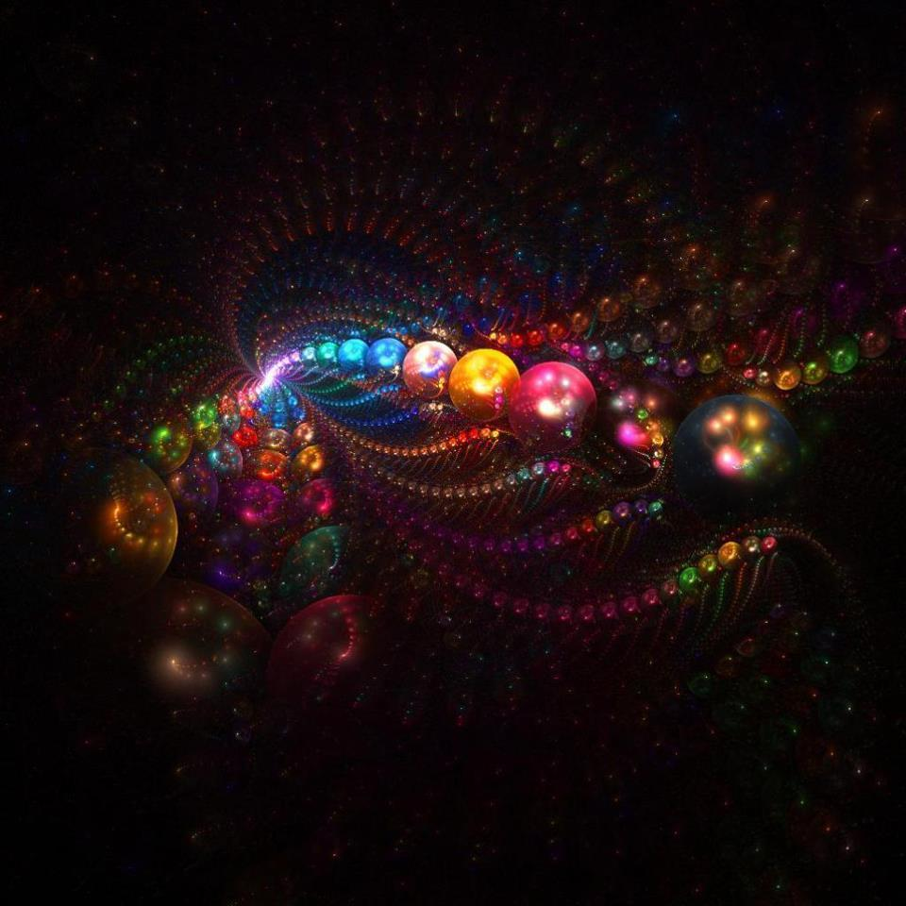
EKADASI,
The day of Lord Hari

Slide 10
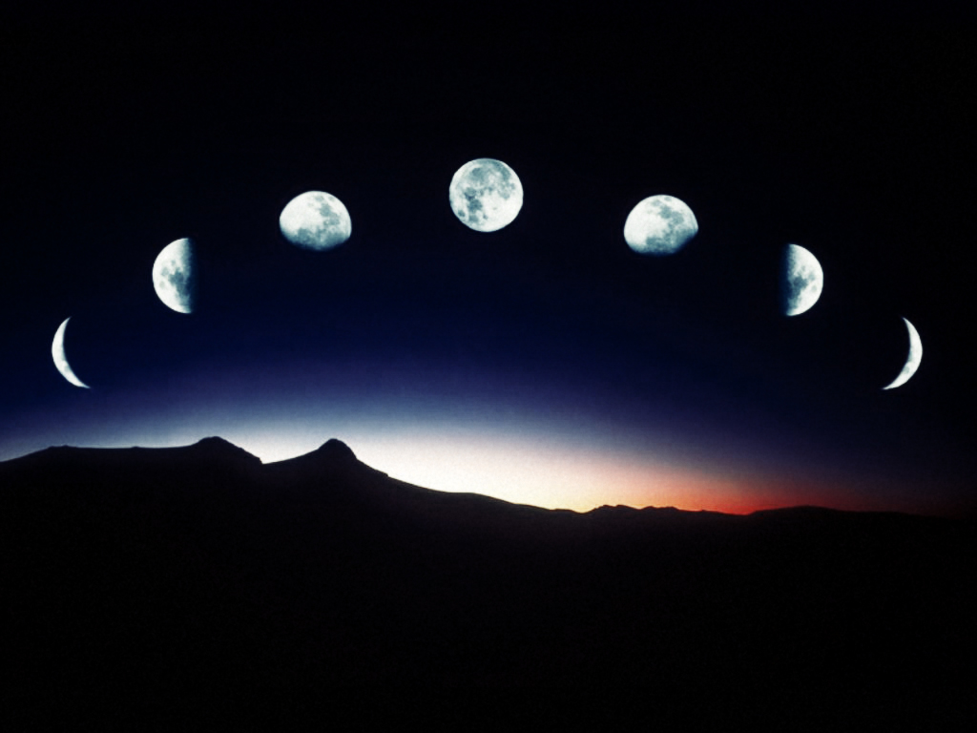
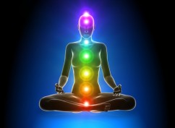
Is there any Science Behind Ekadasi?
Notes:
the question comes, especially from the students and children as what is Ekadasi,
and is there any scientific support behind this.

Slide 11
Notes:
We see the MOON almost every night, and there are lot of things going on related the moon...
As you know, the MOON goes thru different phases.

Slide 12
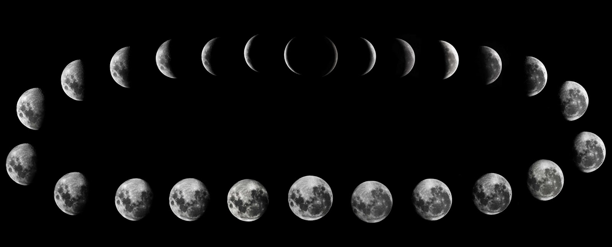
15 Phases of Moon...
Pratipada
Dwitiya
Tritya
Chaturthi
Panchami
Shashti
Saptami
Ashtami
9. Navami
10. Dashami
11. Ekadasi
12. Dwadasi
13. Trayodashi
14. Chaturdasi
15. Purnima / Amavasya
Waxing & Waning
Notes:
Every one of the 15 phases has a unique name.
The name is related to the number from Full moon or no moon.
We see the Waxing and Waning moon..
Ekadasi means 11th day of the 15 phases. This is very special.
Eka (one) after Dasa (10) = Ekadasi
Eka-Dasi – A day after 10th Day..
10th day of the phase of the moon, either from No-Moon, or from the Full-Moon.

Slide 13
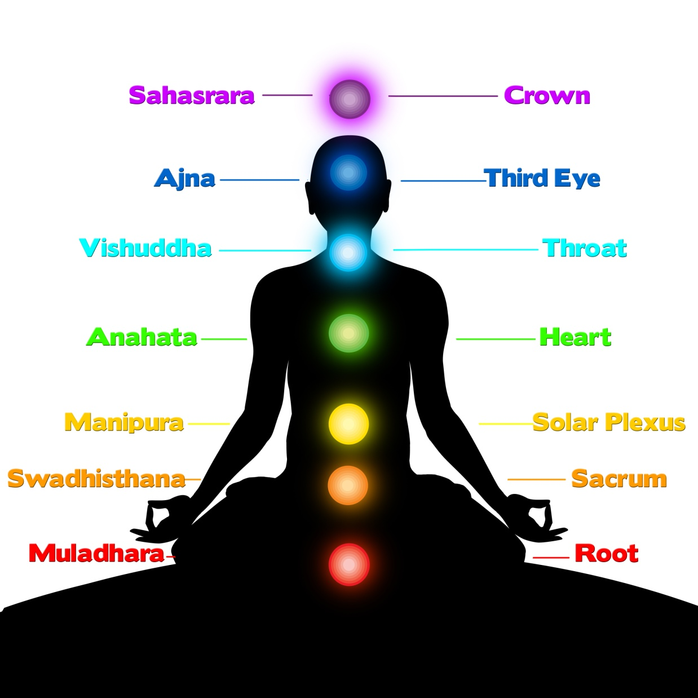
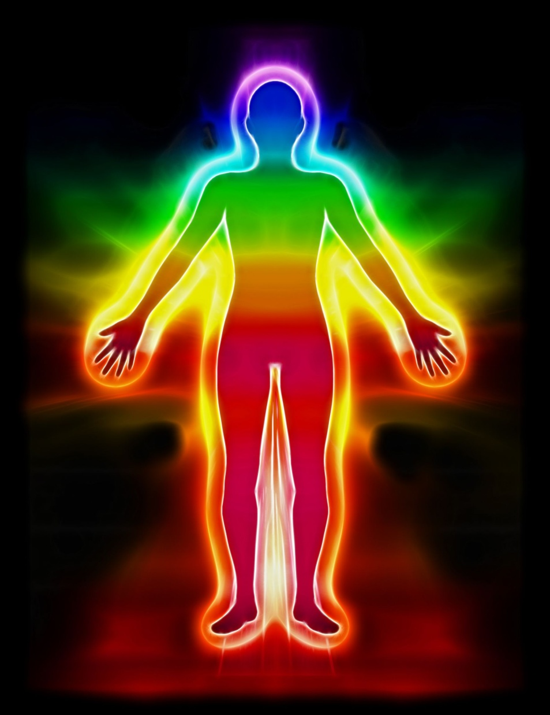
7 Chakras
Our Aura
Notes:
As for our Body and Mind are concerned, there are several things behind the Science of EKADASI..
Our Chakras
Our Aura
Phase of the Moon
Our Mind
On Ekadasi, the atmospheric pressure is the lowest, helping the mind more relaxed.

Slide 14
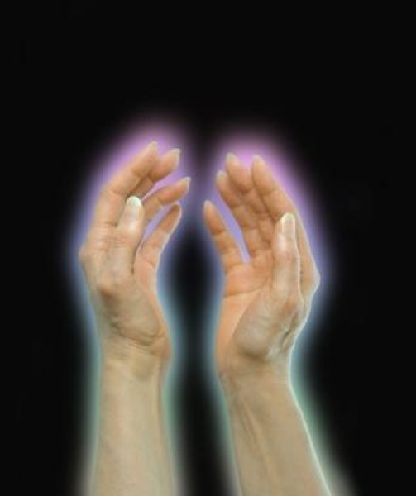
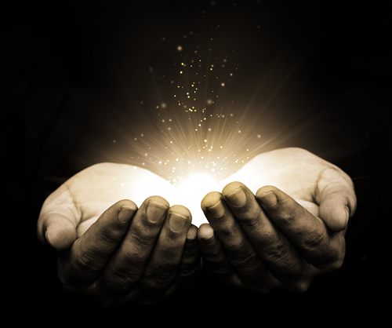
What is Aura?
Can we see Aura?
YES, with training...

Slide 15
Our aura extends anywhere from 0.5” to 6”.
Notes:
It is so thin when we are exhausted..
It so bright and strong when we are refreshed.. especially in the morning..

Slide 16
Notes:
Kirilian found a way of photographing the aura of any living being..

Slide 17
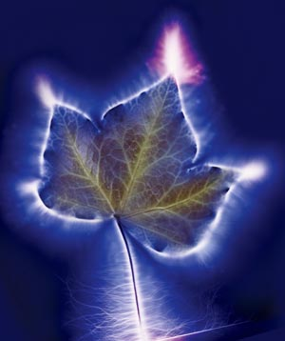
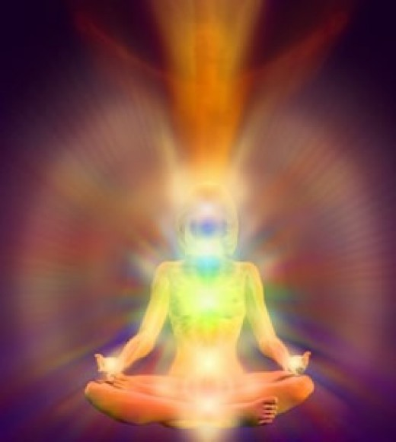

Slide 18
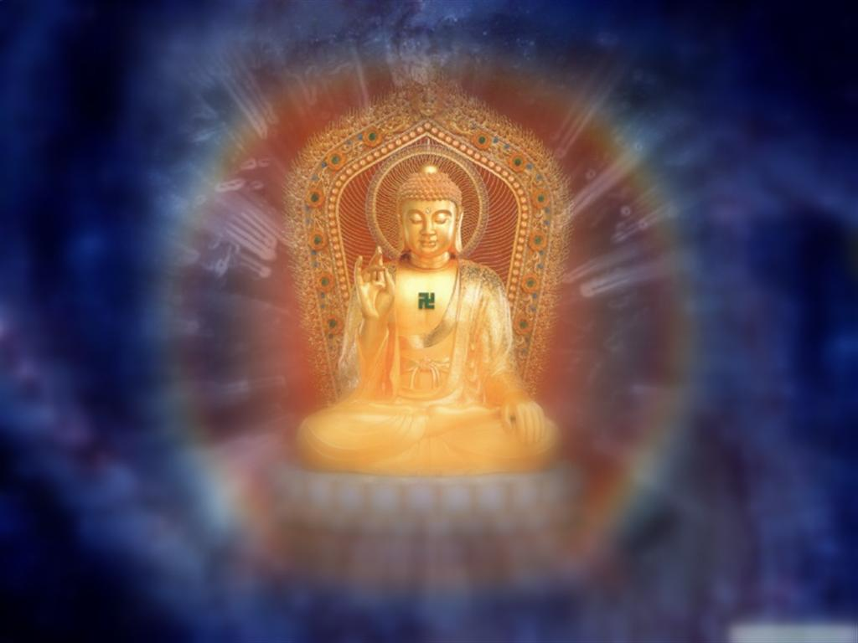
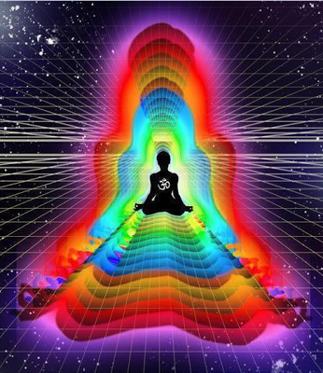
Lord Buddha’s aura extended to 100’s of miles?

Slide 19
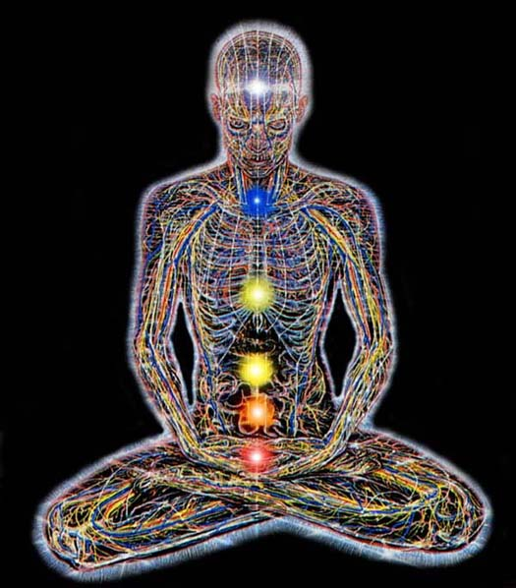
The phases of the moon is connected with our mind..
BODY
MIND
SOUL
Notes:
The moon has effect on our Mind as well..
So it has effect on our BODY and MIND..
What is MIND?

Slide 20
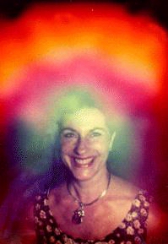
SAD
HARE KRISHNA!
PASSION
Notes:
As the MOON affects our MOOD and hence our AURA itself.!

Slide 21
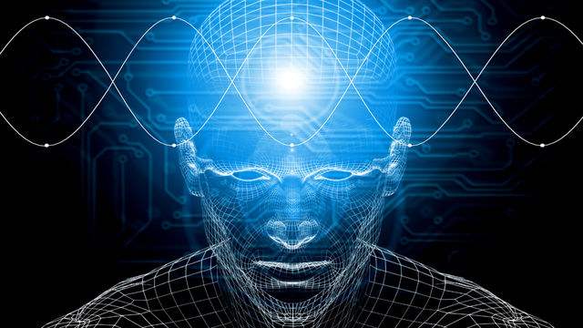
BODY
MIND
SOUL
The word "lunacy" means "insanity“. It comes from the Latin word for "moon"

Slide 22
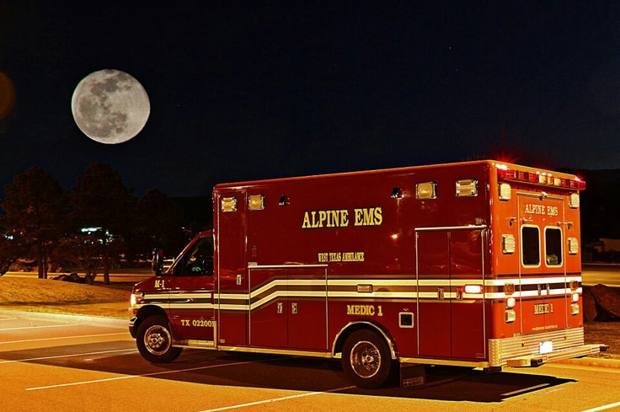
"Just ask an emergency room nurse or a police phone operator. They will tell you that they are busier on nights when there is a full moon."
Notes:
Aggressive acts, emergency health conditions are found to occur from Ekasi to the Full Moon, and Ekadasi to No Moon.

Slide 23
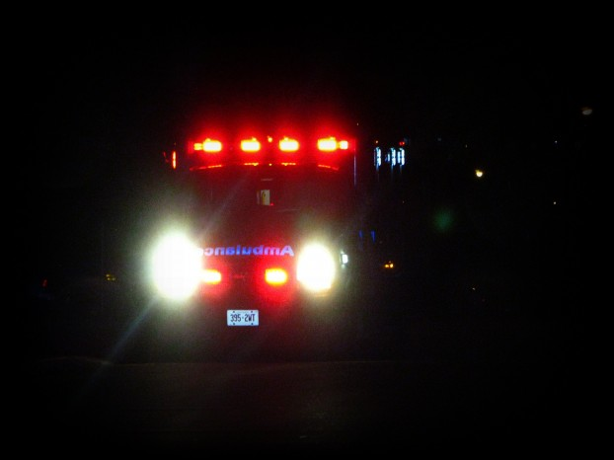
Study: Crimes are much more frequent during full moon..
Reference: J. Psychology, vol. 93:81-83
Notes:
It has been even researched and published in Psychology magazines about more aggressiveness and crimes on or near full moon.

Slide 24
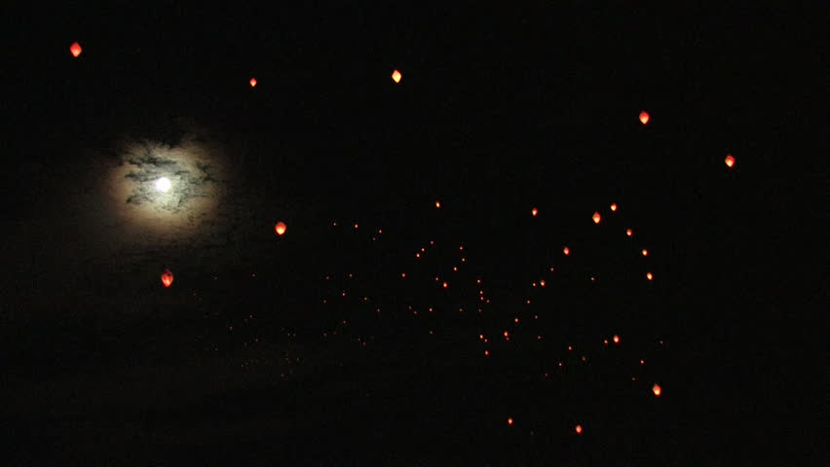
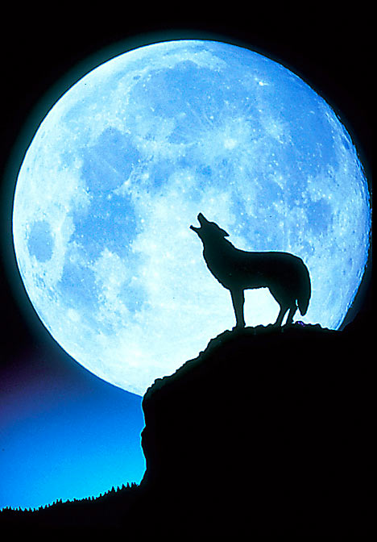
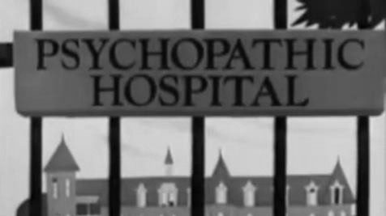
Notes:
On Full Moon Mental disturbance will be more those people who are mentally ill..

Slide 25
The position of the moon influences the MIND to localize from one Chakra to another...
BODY
MIND
SOUL
Notes:
The moon has effect on our Mind as well..
So it has effect on our BODY and MIND..
How many nerves are in the human body?
There are over a billion nerves in our body !

Slide 26
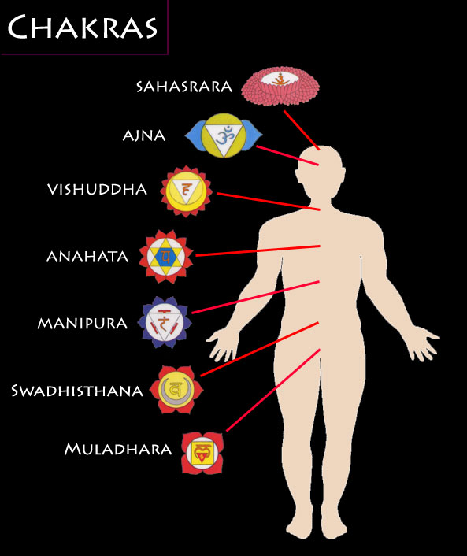
What is special about the 11th day of the moon?
On Ekadasi (11 th day of the moon), our mind is either at:
Ajna Chakra
(3rd Eye)
or
Anahata Chakra

Slide 27
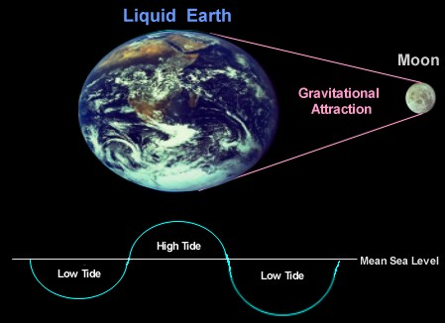
Gravitational Effect of Moon
Notes:
The moon also has control over water..
It pulls the water and causes high and low tides.
The atmospheric pressure on Ekadasi is the lowest..

Slide 28
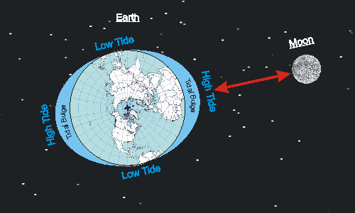
Notes:
If the Tides affect the water, then it should also affect our body..
Because our body is almost

Slide 29
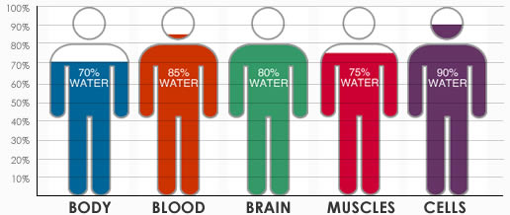
Percentage of water in our body...
Notes:
Because our body is mostly water...
our body is under the influence of MOON.
On Ekadasi day, it will be the lowest atmospheric Presssure.

Slide 30
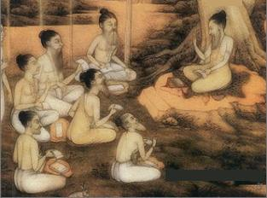
Jaimini Rishi –
Famous for Astrology
What else is going on, on the day of EKADASI..?
Notes:
Now, what other things are involved, which we may not be aware?
The Padma Puraana, describes the following relevance of Ekadashi:
Jaimini Rishi, a renowned sage, once became inquisitive about the Ekadashi vow, so he inquired from the great sage Vyaasa about the same.

Slide 31
Notes:
Vyaasa said that initially, when the world was manifested, Lord Vishnu created a demonic creature
(Paapa-Purusha) that was the embodiment of all types of sins.
This was done in order to punish all beings who would choose the path of evil.
Subsequently, He also created the Yamaloka - the cosmic penitentiary,
so that anyone who sinned (with symptoms of Paapa-Purusha in him) would be sent there.

Slide 32
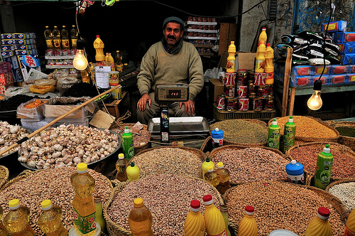
On the day of EKADASI, All the sins from all the worlds will reside on Grains and beans..
So, do not eat them!

Slide 33
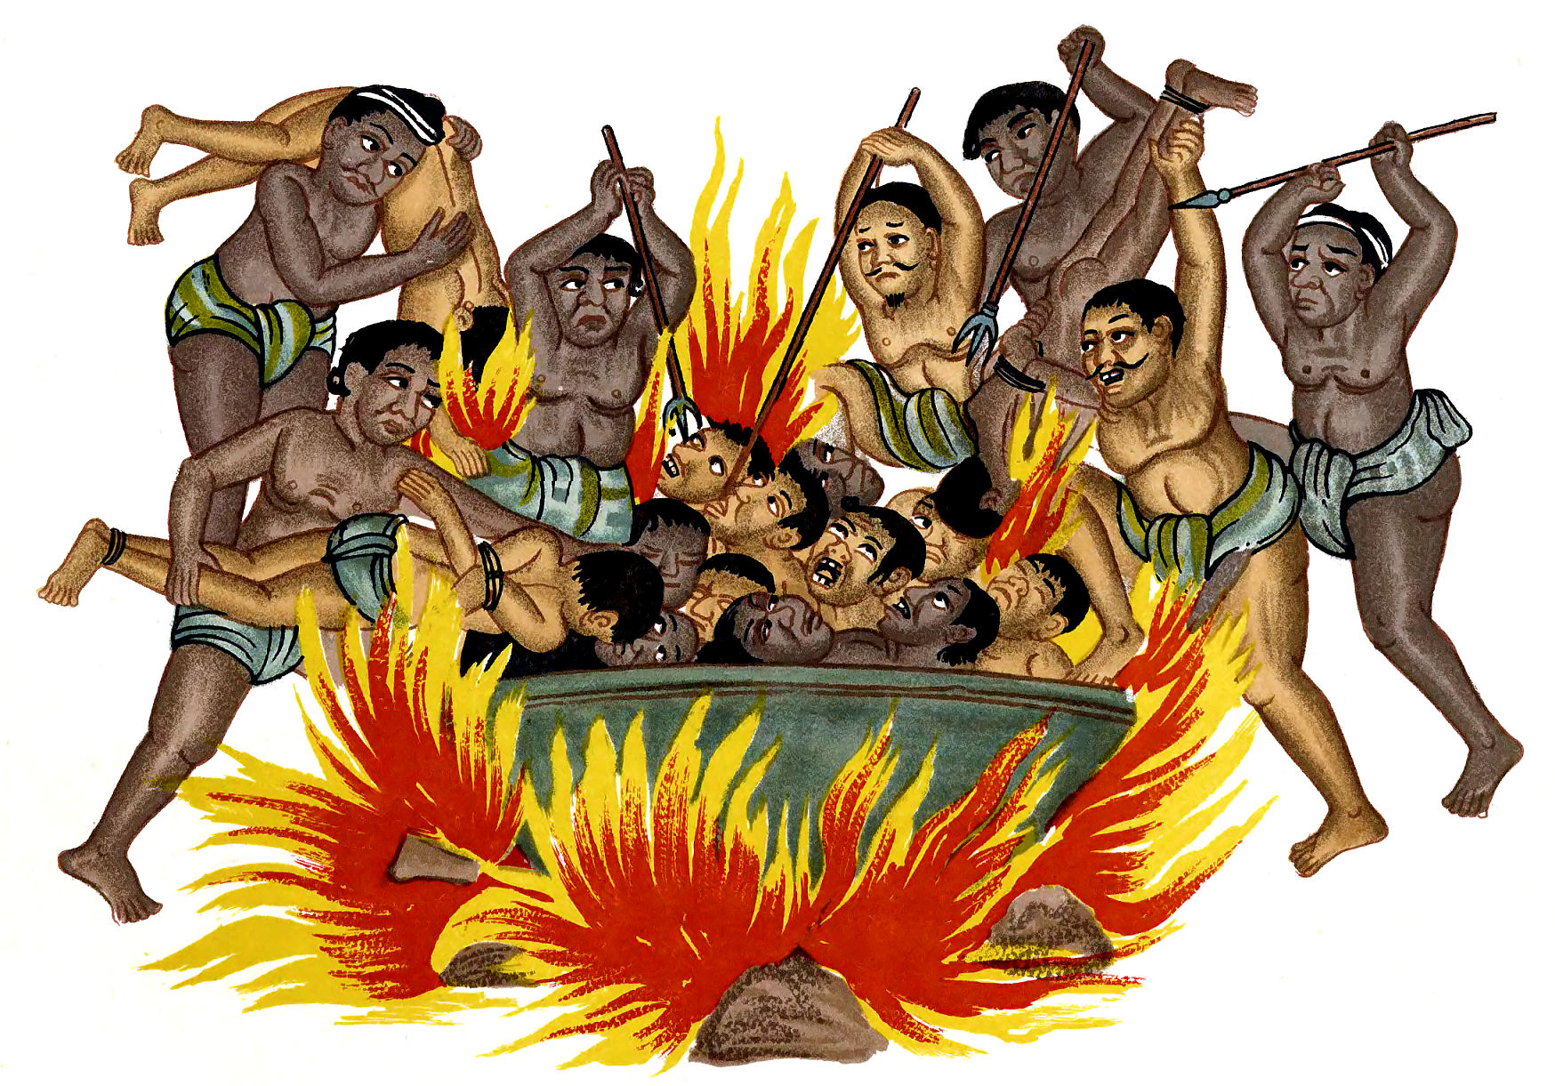
By fasting from Grains on Ekadasi, our sins are washed out...
So, we don’t go to Hell for our sins..
Notes:
Once upon a visit to Yamaloka, Lord Vishnu noticed the miserable state of the living entities there undergoing "corrections", and had pity on them. So He created Ekadashi from His own being, and decided that anyone undertaking the Ekadashi vow would be cleansed of their sins and will not have to visit the cosmic penitentiary.
Becoming aware of this, the Paapa-Purusha became alarmed. He immediately went to Lord Vishnu and pleaded that because of these Ekadashis soon he may not have any sustenance. So the Supreme Personality of Godhead gave him a benediction that he may reside in the Beans, Grains and Cereals on the Ekadashi days. Thus he may affect anyone who consumes these on an Ekadashi. At this the Paapa-purusha became satisfied.
The Ekadashi day being such a wonderful day to cleanse one's offences is thus respectfully also celebrated as the day of Lord Hari (the Supreme Lord God).

Slide 34
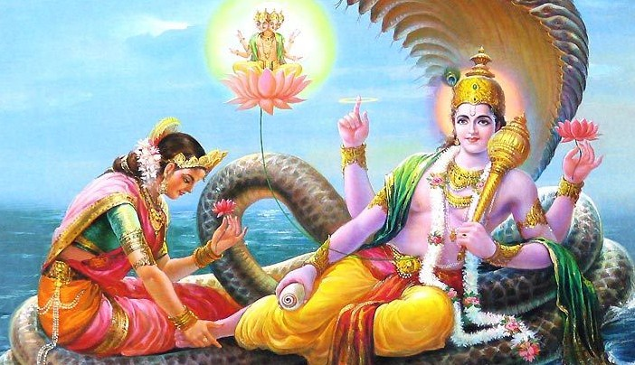
Notes:
What else?
Lord VISHNU changes His lying position on the day of Ekadasi.

Slide 35
Some Ekadasis are very special...
VAIKUNTHA EKADASI
Notes:
Also some EKADASIS are very special..
Vaikunta Ekadasi
This is very auspicious for Sri Vaishnavas mainly.

Slide 36
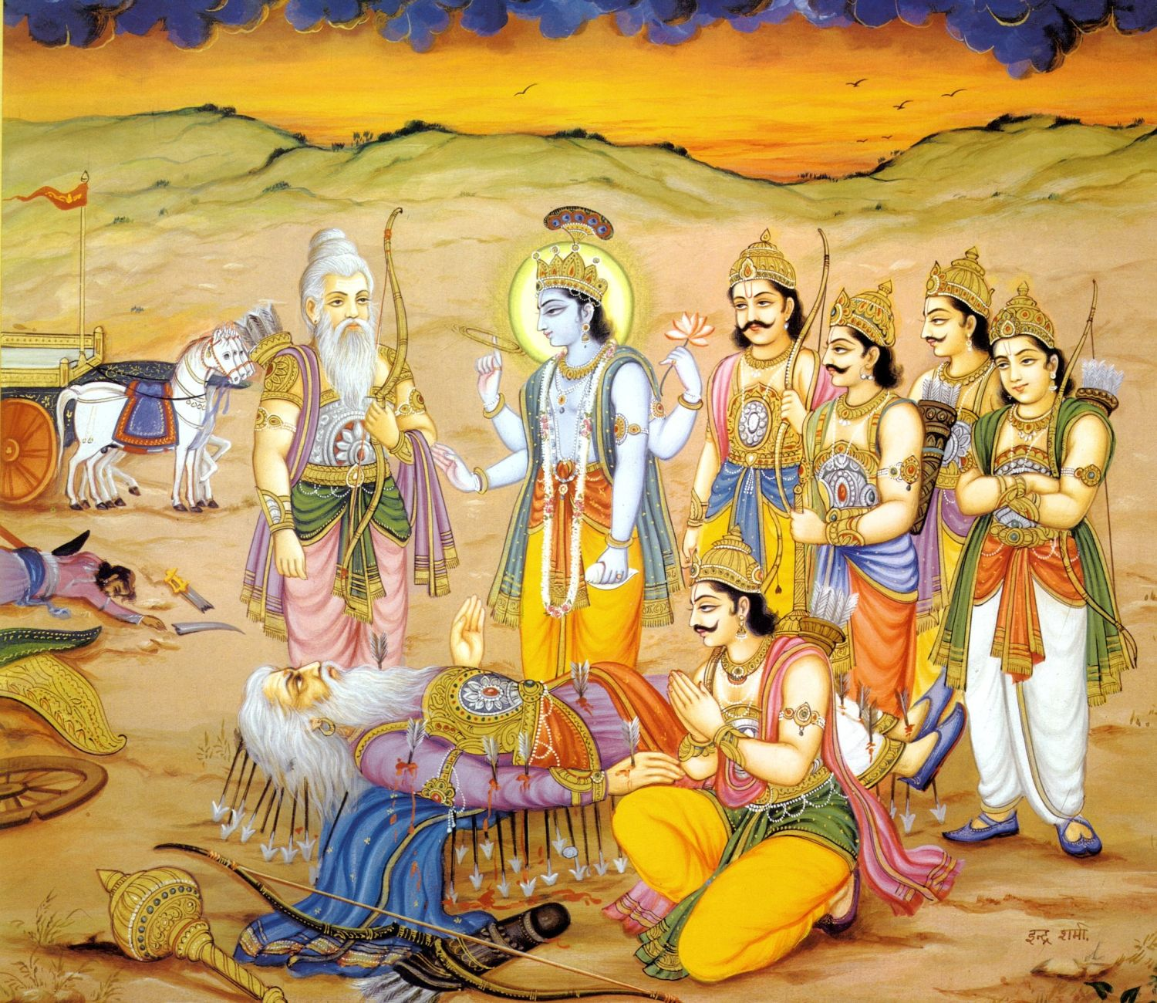
BHISHMA EKADASI
Notes:
Bhisma Ekadasi – On this Ekadasi day, Bhisma narrated Vishnu Sahasranama
Reciting Vishnu Sahasranama gives one Moksha – free from birth and death

Slide 37
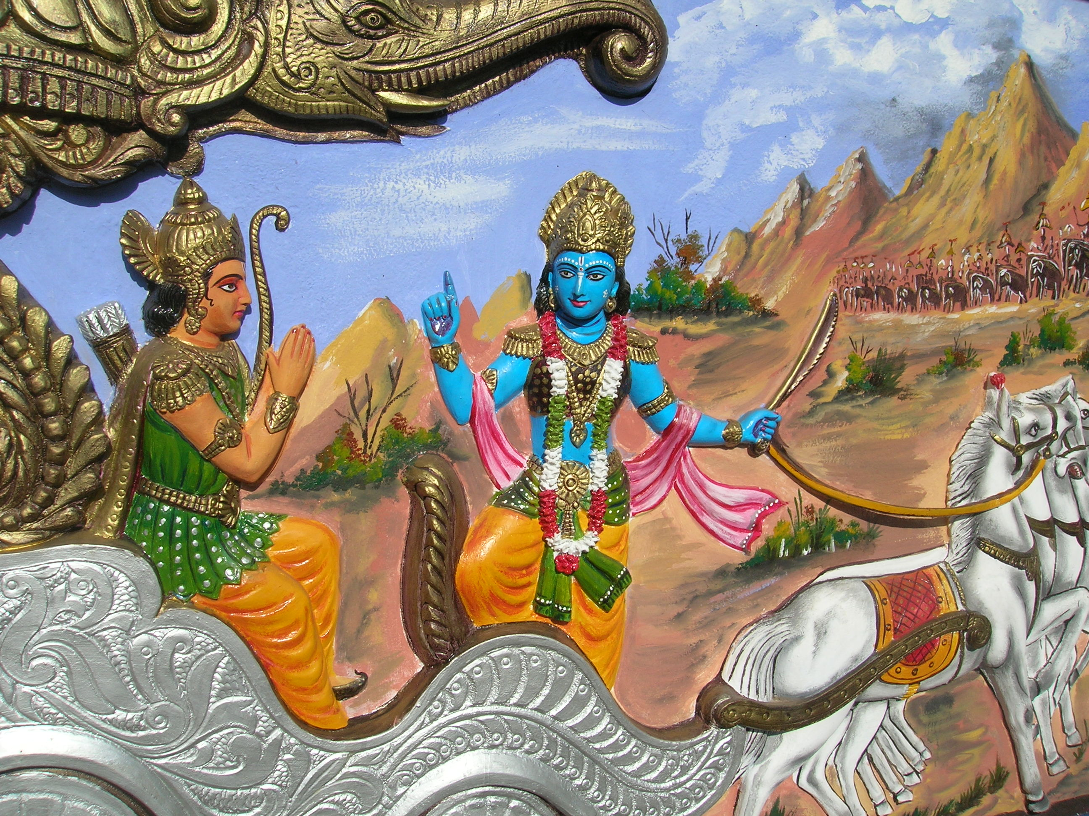
MOKSHADA EKADASI
Notes:
Mokshada Ekadasi – The same day as Gita Jayanti...
This was the day Lord Krishna taught Bhagavad Gita to Arjuna.

Slide 38
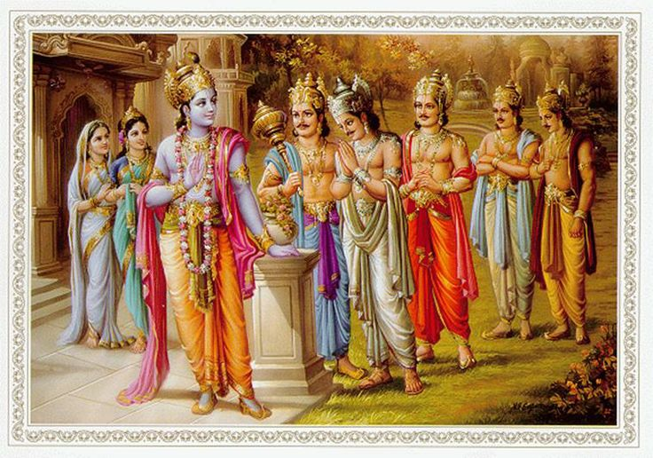
Notes:
Pandava Ekadasi is very special as it was observed by Pandavas.
As Bhima cannot fast for Ekadasis, this was the only day suggested by Lord Krishna to Bhima to fast completely, not even taking water.
This was a special arrangement given to Bhima, not for us.
We should fast for all the Ekadasis.

Slide 39
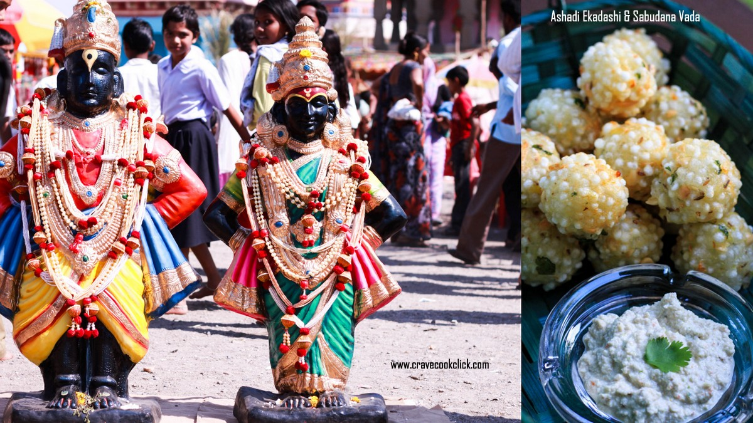
ASHADA EKADASI
Notes:
On Ashada Ekadasi, a very grand function is held in Pandarpur, Maharashtra.
This day, a huge yatra or religious procession of pilgrims known as Pandharpur Ashadi Ekadasi Waari Yatra culminates at Pandharpur, in Solapur district in south Maharashtra, situated on the banks of the ChandraBhaga River. Pandharpur is main center of worship of the deity Vithoba, a local form of Vishnu. lacs of pilgrims come to Pandharpur on this day from different parts of Maharashtra. Some of them carry Palkhis (palanquins) with the images of the saints of Maharashtra. Dnyaneshwar’s image is carried from Alandi, Tukaram’s from Dehu, Eknath’s from Paithan, Nivruttinath’s from Trimbakeshwar, Muktabai’s from Muktainagar, Sopan’s from Sasvad and Saint Gajanan Maharaj from Shegaon. These pilgrims are referred to as Warkaris. They sing Abhangas (chanting hymns) of Saint Tukaram and Saint Dnyaneshwar, dedicated to Vithoba.

Slide 40
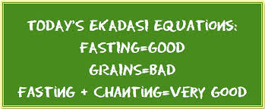
On Ekadasi, controlling the mind is very easy!
What should we do on Ekadasi?

Slide 41
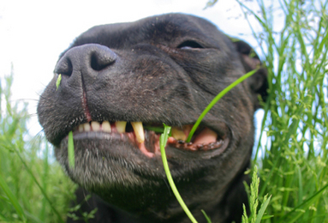
Most of the FREE living animals feel Ekadasi day!
Humans lost it !

Slide 42
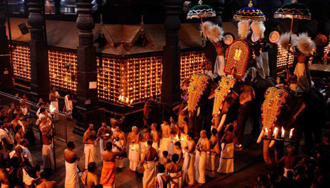
I am going to tell you a REAL STORY...
Notes:
This is GURUVAYUR in KERALA India.
This is considered as one of the BHULOKA VAIKUNTHA..

Slide 43
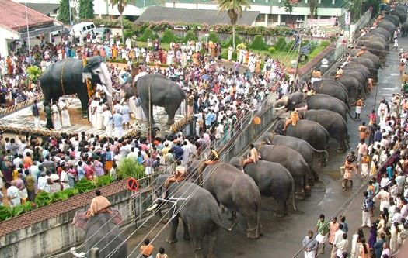
Notes:
There were so many elephants serving the Lord in the temple.
Before the invasion of Muslims, there were hundreds of them..

Slide 44
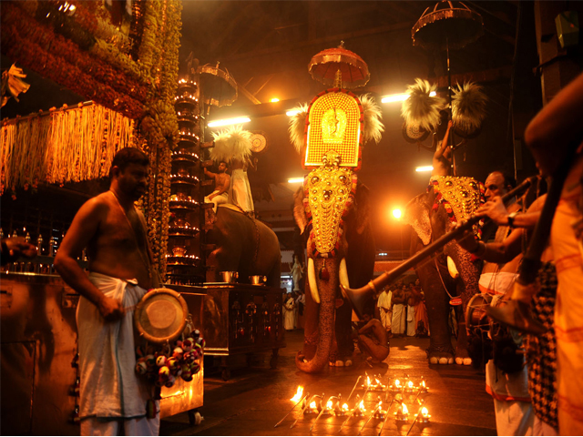
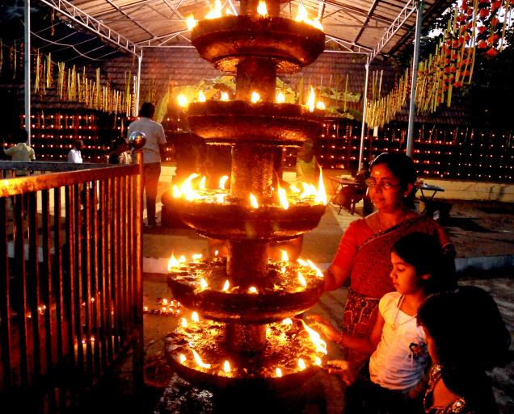
Notes:
The temple opens at 3 AM every day.
On the days of EKADASI, it is very special.

Slide 45
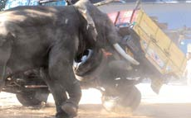
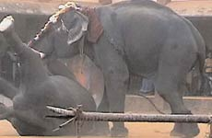
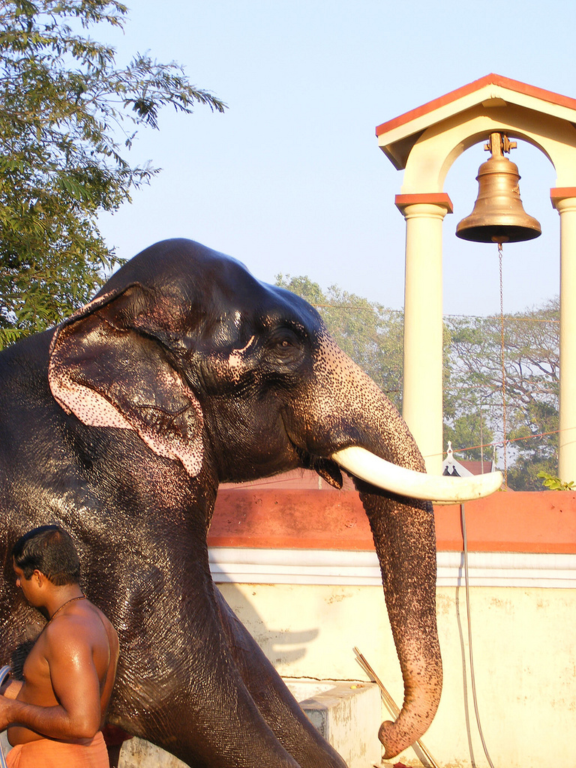
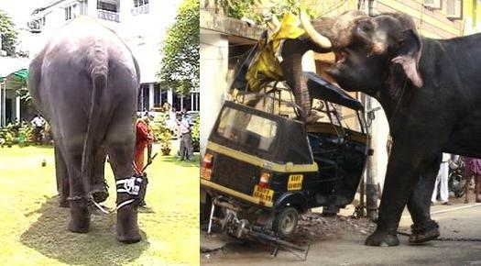
Notes:
Once a new baby elephant was brought to the temple..
His name of KESHAVA
But he was very mischevous.
It was giving so many problems.
Then the PRIEST ordered to tie the elephat near the BHAJAN ROOM every day.
the BHAJANS and CHANTING all went into the Elephant.
Slowly He developed Bhakti and devotion to Krishna..

Slide 46
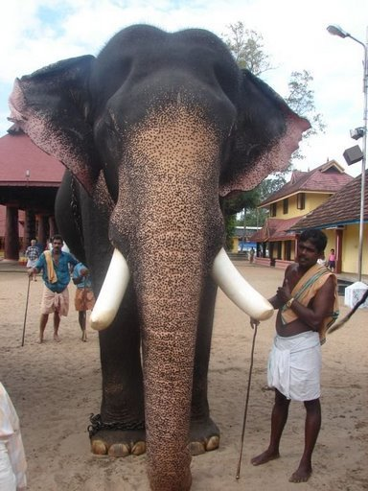
Notes:
Keshava fasted for EVERY Ekadasi !
He knew exactly when the Ekadasi was !!
Even favorite food given, he never ate any!
Thus became a devotee of Krishna !

Slide 47
It was
Ekadasi Day
Dec 2, 1976
3 AM
Mangala Arati

Slide 49
At 3 AM, KESHAVA suddenly showed up in the temple..!
Notes:
Everyone surprised how he came!
He circumambulated the temple.
Stood in front of main temple
Bent down his huge front legs
Bowed down his head to ground.
With surrender, he left the body.
It was 72 years old

Slide 50
Krishna – The deity of Krishna
Same that was worshipped by Krishna

Slide 53
Main Benefits of Fasting for EKADASI
Healthy Body & Mind
Sins are washed away
Develops Will Power
Gives clear thinking
Increases concentration power
Toxins are flushed out
Extra fats are burned out
Body works on curing diseases
Krishna Bhakti develops
Notes:
Who should fast?
Anyone age 8 to 80..

Slide 54
How to follow Ekadasi?
Do NOT eat any Grains or Beans.
Chant & Sing Bhajans
Ekadasi and Dwadasi days are posted on our web
www.gokulbhajan.com

Slide 55
Levels of following Ekadasi
3 meals - No grains and beans
Single meal at night – no grains/beans
Not taking any meal for the whole day but only water
Not even drinking water
No food/water, Not even sleeping the whole night

Slide 56
How to break the fasting on Dwadasi (Next day)?
Break the fasting at proper time!
Facing East, chant:
’Om namo bhagavate vasudevaya’
If offering the result to any one else, tell their name(s)
Then take grains/prasadam
Tomorrow is EKADASI: 2015-Nov-22 (Sun) Name of Ekadasi: Utthana Break the Fasting Next day (Monday) at: 06:59 - 10:21 AM

Slide 57
F-09
Govindā Govindā
Gokula Nandana Gopāalā
Vrindāvana Dhara Nanda Bālā
Giridhara Bālā Gopālā ... (Govinda)
Yashoda Nandana Gopālā
Yamunā Teerā Gopālā
Vrindavana Dhara Nanda Bālā
Giridhara Bālā Gopālā ... (Govinda)
Nanda Nandana Gopālā
Navanidha Chorā Gopālā
Vrindāvana Dhara Nanda Bālā
Giridhara Bālā Gopālā ... (Govinda)
Rādhā Ramanā Gopālā
Ramyaka Bālā Gopālā
Vrindāvana Dhara Nanda Bālā
Giridhara Bālā Gopālā ... (Govinda)
(Nannannā Nānanā
Nannana Nannan Nananānā
Nannā Nannā Nananānā
Nananna Nanna Nananānā)

Slide 58
QUESTIONS?
Notes:
What are the benefits of fasting for Ekadasi?

Slide 59
THANK YOU!

Slide 61
Other names of Ekadasi
Hari Vāsa
Mādhava Titi
Bhakti Janani
Krishna Vasati

